Slide 2

IT Security Trends
August 2019

Slide 3


Christian Renaud
Research Vice President,
451 Research
As Research Vice President, Christian covers the ongoing digitization of the physical world around us. For 25 years prior to joining 451 Research, Christian built nationwide networks at large and small enterprises, worked with Fortune 50 companies in the systems integrator channel, built products at Cisco Systems and ran the company's New Markets and Technologies team. He has been the CEO of multiple companies, worked in venture and angel capital, and has served as an advisor to G20 and European Commission projects.
451RESEARCH.COM
©2019 451 Research. All Rights Reserved.
Notes:
Photos can be added to all frames by clicking the icon and selecting from your computer. To remove the photo but keep the frame, simply select it and hit the ‘Delete’ key. To move the photo around inside the frame, select Picture Tools/Format/Crop and drag the placed image. Once image is placed, right click on it and select “Send to back” to expose the name box. ***If your photo looks pixelated using this layout, please pick a layout from the next 2 slides and tweak accordingly***

Slide 4
Sweeping changes
Monolithic
Microservices
Self-contained
Service mesh
APIs
‘Functions as a Service’
INFOSEC?
Waterfall
Agile
IT
DevOps
Datacenter
Cloud
Enterprise
IoT, OT, consumer

Slide 5
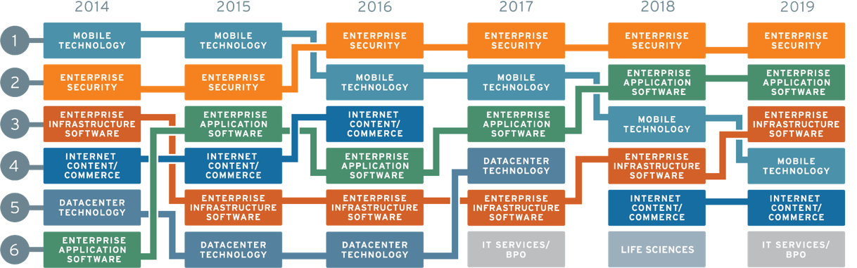
M&A outlook, by tech sector
Top-ranked sectors for acquisition activity in the coming year
Source: 451 Research’s Tech Banking Outlook Survey
Notes:
To give a couple of examples of what you’ll find in out M&A OUTLOOK report ..
As to where the M&A dollars will be spent in the coming year, for the fourth consecutive survey, tech bankers forecast that enterprise security would show the biggest increase of roughly a dozen tech sectors.
Volume up 50% … so something going on there.
ESP – 5 analyst, take a look at how the shift the in architectures or computing models means to security … and how to position your company to take advantage of those shifts. Security always lags the introduction of new tech -- IoT or mobility or cloud.
Zero trust – maybe around biometrics
Or App Sec -- how to get useable tool into developers’ hands.
Attach names of companies they’ve covered to those trends.
Same true for the other key sectors we cover.

Slide 6
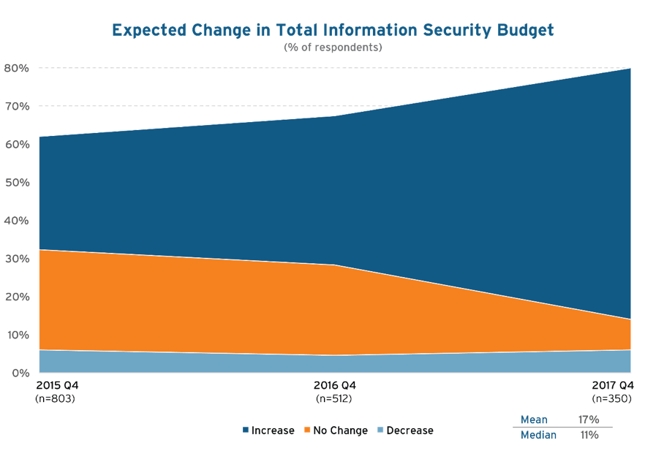
Continuation of an upward spending trend
By what percentage
do you expect your organization’s total information security budget to change in
the coming year compared to this year?
Source: 451 Research’s Voice of the Enterprise: Information Security, Budgets & Outlook, published Q1 2018

Slide 7
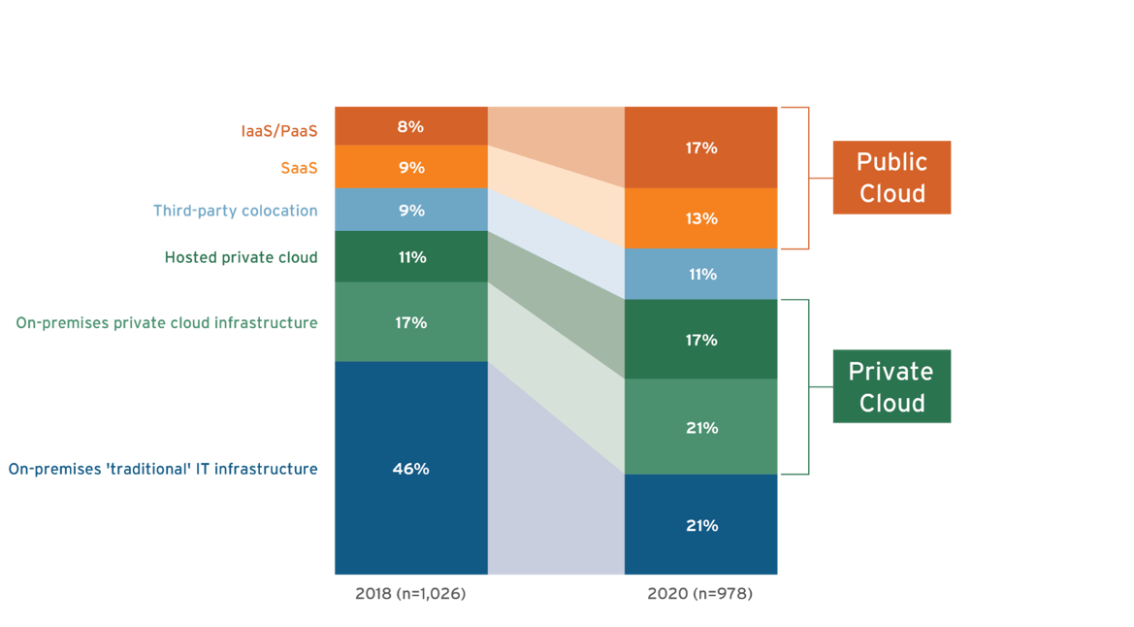
Cloud transformations are accelerating
+113%
+76%
+44%
+22%
+36%
-54%
Q: Thinking about all of your organization’s workloads/applications, where are the majority of these currently deployed?
Q: Thinking about all of your organization’s workloads/applications, where will the majority of these be deployed two years from now?
Source: 451 Research’s Voice of the Enterprise: Digital Pulse, Workloads & Key Projects 2018

Slide 8
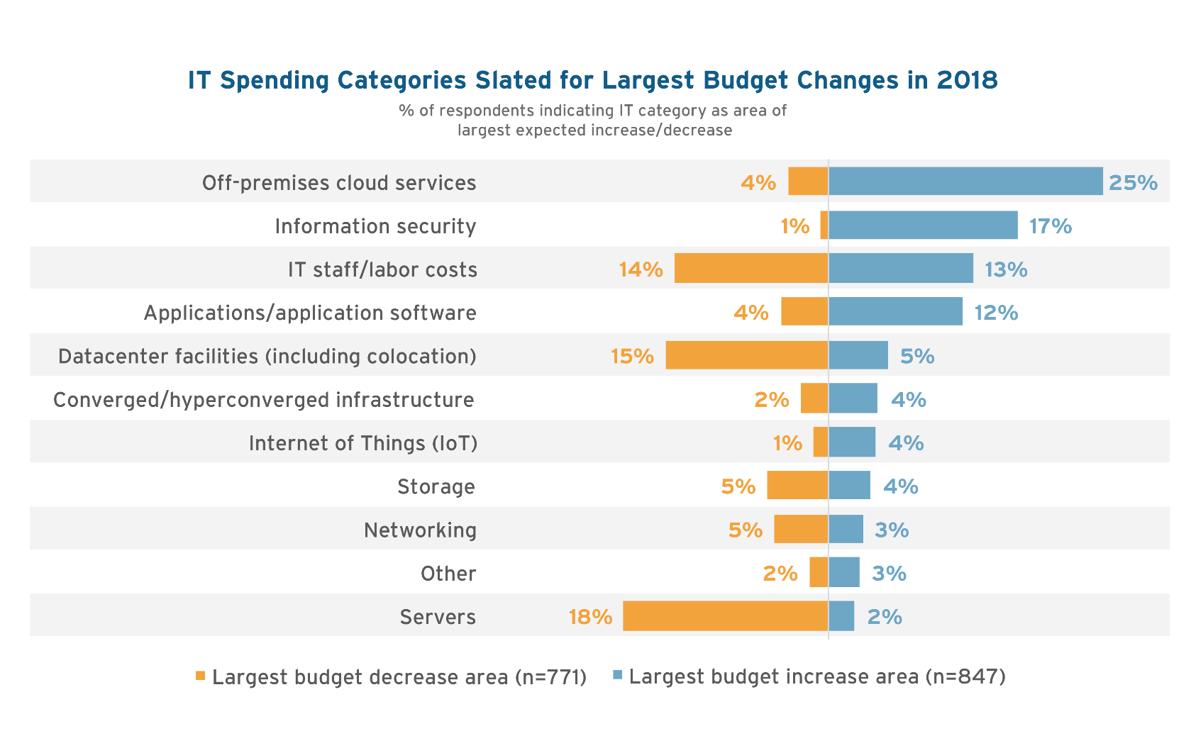
Security: Seen in context
Source: 451 Research’s Voice of the Enterprise: Digital Pulse, Workloads and Key Projects 2018

Slide 9
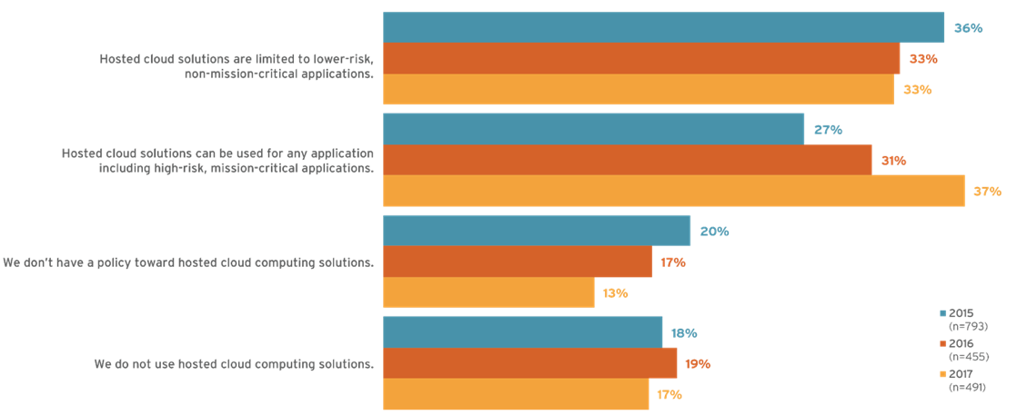
Security inhibitors toward deploying high-risk, mission-critical applications to the cloud are dropping
Hosted cloud solutions are limited to lower-risk, non-mission- critical applications
Hosted cloud solutions can be used for any application including high-risk, mission-critical applications
We don’t have a policy toward hosted cloud computing solutions
We do not use hosted cloud computing solutions
Q. How would you best describe your organization’s policy toward usage of hosted cloud computing solutions (hosted private cloud, IaaS or PaaS) today?
Source: 451 Research’s Voice of the Enterprise: Information Security, Budgets & Outlook, published Q1 2018

Slide 10
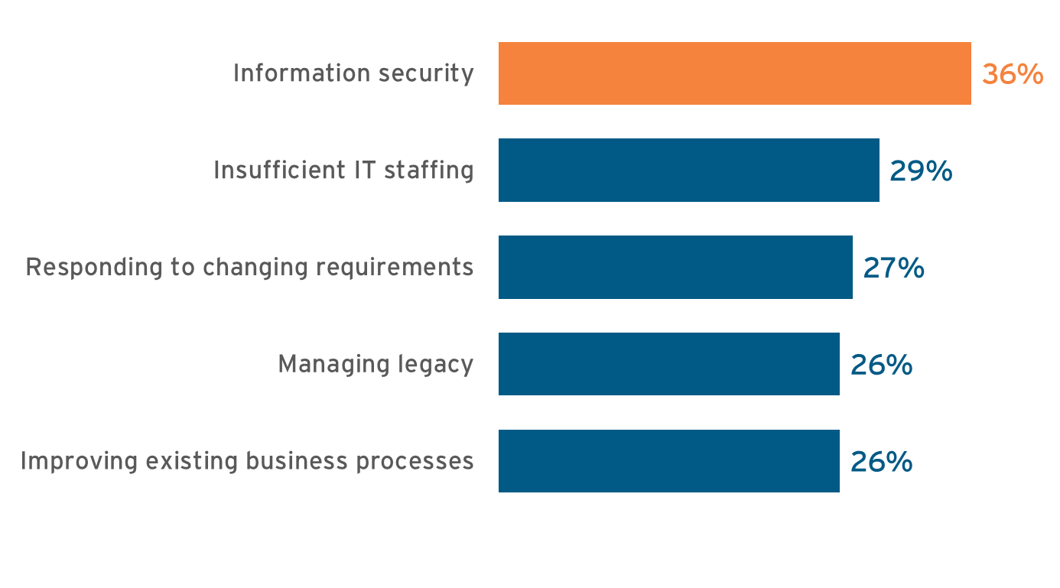
What’s the top pain point in IT?
Source: 451 Research’s Voice of the Enterprise: Digital Pulse, Organizational Dynamics 2018 (n=1,145)

Slide 11
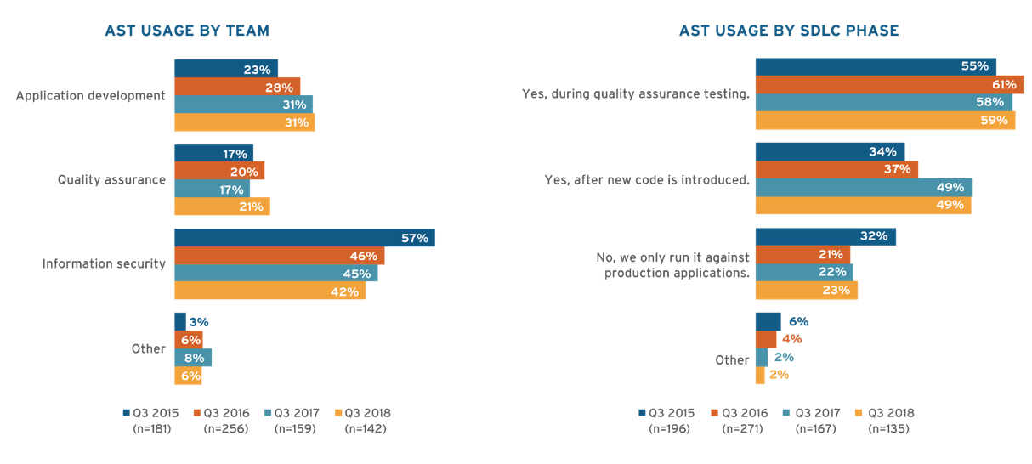
DevOps: Impact on development
text
Q. How is usage of application security tools allocated across the following teams in your organization?
Q. Do you run your application security vendor’s tools during different phases of the software development lifecycle (SDLC) as part of a secure SDLC?
Source: 451 Research’s Voice of the Enterprise: Information Security, Budgets & Outlook, published Q1 2018
Notes:
AST tools always belonged in the hands of developers. The reasons aren’t complicated to understand – a correction of a software bug closest to its creation is the cheapest possible correction. As a created security vulnerability moves left across the software development lifecycle (SDLC), more potential hands touch the vulnerability from quality assurance testers to user acceptance testing and, in the worst-case scenario, it reaches production and is exploited by an attacker. Developers aren’t known for having a lot of free time, however, so SDLC integration must be frictionless, which means classic approaches for AST are needed (e.g., integrated development environment integration, but also the ability to plug into DevOps toolchains, automated testing, developer education, and a low level of context switching for developers) for application security tools to be effective.
Application security is holding that shift left. 49% of respondents note they run their application security testing (AST) tools after new code is introduced, the same figure as last year, and significantly up from the 34% who said the same in 2015. Those who only run AST tools against production environments has dropped 10% in the same period. Similarly, 31% is the allocation given to application development teams in terms of AST tool usage, the same 31% as last year, and up from 23% in 2015. Information security’s allocation of usage has dropped to 42%, still the largest, but in terms of clear trend lines, that is down from 57% in 2015.

Slide 12
IaaS features planned for implementation
text
Q. Which of the following IaaS features is your organization planning to begin using in connection with IaaS/public cloud services during the next year? Please select all that apply. (n=268)
Source: 451 Research’s Voice of the Enterprise: Cloud, Hosting & Managed Services, Workloads and Key Projects 2018
Notes:
03:00 - 04:00

Slide 13
Most important skills for cloud
text
Q. Which of the following skills categories are most important for managing your organization’s cloud computing environment? Please select all that apply. (n=577)
Source: 451 Research’s Voice of the Enterprise: Cloud, Hosting & Managed Services, Organizational Dynamics 2018

Slide 14
Impediments in deploying IoT initiatives
text
Q. Which of the following are, or do you expect to be, impediments to deploying IoT initiatives? (n=515)
Source: 451 Research’s Voice of the Enterprise: Internet of Things, Organizational Dynamics 2019

Slide 15
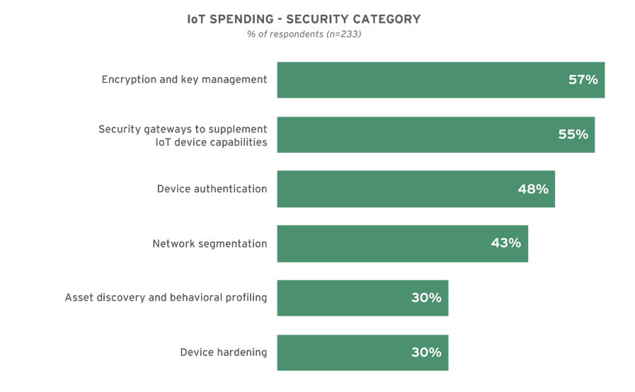
IoT Security Spending Priorities
text
Q: What security products or capabilities will your organization be purchasing in 2019 to support IoT initiatives?
Source: 451 Research’s Voice of the Enterprise: Internet of Things Budgets and Outlooks 2019

Slide 16

Thank you
US +1 212.505.3030 EUROPE +44 (0) 203.929.5700
^{451research.com}
^{@451Research}
^{New York}
^{London}
^{Boston}
^{Washington, D.C.}
^{San Francisco}
Notes:
Feel free to customize this slide with your personal contact information

Slide 17
The Future of PKI in
the Modern Enterprise

Slide 18

Jason Soroko
CTO of IoT
20-year veteran of PKI industry
IT & OT offense research since 2010
Automotive security
patent holder
Led acquisition team for Icon Labs
Continually in contact with customers, partners,
and analysts about IoT security needs

Slide 19
About Sectigo
World’s largest commercial CA
More than
100 million certificates issued
700,000
active customers globally
99%
enterprise customer
retention rate
Founded
1998
Contributor to many industry standards groups
Notes:
Founding member of CA/Browser Forum
Leader in establishing CA baseline requirements

Slide 20



PKI in the modern enterprise
It’s a new IT security landscape
New computing architectures
New and emerging threats
PKI rises to meet the challenge
Automation
Orchestration
PKI for connected devices (IoT)
Identity through PKI remains essential to security
Basic capabilities are unmatched through any other approach
PKI has to evolve to fit the new use cases

Slide 21
Identity in the new
enterprise architecture

Slide 22




PKI in the modern enterprise
Traditional PKI
use cases
New transformational
use cases
SSL/TLS
User authentication
Device authentication
Document signing
SSH keys
S/MIME
Mobile/BYOD
DevOps
Authenticated email
Multi-cloud
IoT
+

Slide 23




New use cases introduce new risk factors
New transformational use cases
Risk factors
Criminal activity
Mobile/BYOD
DevOps
Authenticated email
Multi-cloud
IoT
Proliferation
of certificates
Short lifespan
Rogue certificates
Heterogenous environments
Technical silos
Human error
Social engineering
Breaches and information theft
Crypto jacking
Spear phishing/BEC
Botnet participation
Business performance
Performance/outage risk
Slow time to delivery
Compliance failure
Lost agility
Compatibility
Cost

Slide 24

New transformational use cases introduce new risk factors

Slide 25






Enterprises face vast risk from certificate failures
2017
2018

Slide 26




The attack surface now includes all connected devices
Risks now go far beyond fraud

Slide 27
PKI rises to
the challenge

Slide 28






PKI has many advantages as an identity solution
Proven
Versatile
Reliable
Secure
Ubiquitous
Widely understood

Slide 29




But PKI had a perception problem
Painful
Slow to implement
Expensive

Slide 30



Purpose-built PKI addresses these concerns
Usable
Agile
Economical
Scalable

Slide 31


Qualities of the new PKI
New requirements
Old requirements
still matter
Automation
Orchestration
Scalability
Crypto agility
High uptime
Interoperability
Governance

Slide 32




Common PKI elements serve all varieties of use cases
100% automated
VPN
Breaks out to these components
SSH
DevOps
Public CA
Private CA
Networking
Gear
Public &
Private Web
Server
Certificate Manager
Identity Assurance
Issuance
Mobile
Devices
Email Digital
Signature &
Encryption
Vault
Revocation
Reporting
Windows
Hello for
business
Renewals
Code
Signing
Digital
Sign Forms
loT
Cloud
Access
Certificate provisioning

Slide 33
Addressing
today’s use cases

Slide 34




Transformational use cases
Mobile/BYOD
DevOps
Multi-cloud
loT
Email

Slide 35




Email risks are vast
BEC and other spear
phishing rises fast
Unencrypted emails
are stolen and leaked
APWG: more than 80,000 unique phishing sites
in March, 2019
Phishing remains
rampant
  2017
  $1.2 billion
  2018
  $675 million
  YoY
  Growth
  78%
Lost S/MIME keys
mean lost emails

Slide 36










Sectigo secure email S/MIME signing architecture
cloud
Enterprise
Directory
ID
ID
Recipient
Public
Certificate
Authority
Private
Certificate
Authority
Windows
Outlook
Secure
Email
Gateway
ID
EMM
Mail App
ID
Certificate Manager
ID
ID
Mail
Server
Encryption
Key Escrow
Apple Mail,
Samsung,
etc
ID
Notes:
Automated encryption key escrow
So easy to use, near 100% encryption
Automated certificate provisioning, with no employee intervention.
Utilize the encryption/decryption/sign built in to popular mail applications
Only vendor that delivers this capability, using publicly trusted digital signatures

Slide 37



Mobile/BYOD device certificates
Other
74.8%
1.2%
0.3%
22.8%
0.9%
Notes:
Some of these transformational use cases, your old PKI won’t make it any more. Non-Microsoft. Provisioning certificates to these things is a challenge with traditional PKI approaches.

Slide 38


Mobile/BYOD PKI architecture
Networking equipment
Windows CA proxy
Laptop
Restful API
APP
Applications
loT
SCEP EST RFC7030 EMM proprietary
Mobile

Slide 39

Certificates for DevOps
code
deploy
plan
Dev
release
Ops
build
operate
test
monitor

Slide 40




code
deploy
BREACHES, OUTAGES,
NON COMPLIANCE
plan
Dev
release
Ops
build
operate
Volume of certificates
test
monitor
Shorter life span of certificates
Decentralization of control
Complex environments

Slide 41




DevOps PKI architecture
cloud
Enterprise
Webservers, load balancers
SSH client server
Istio/Citadel
Container
Private
CA
Public
SSL CA
CA Plugin
TLS
Kubernetes
Certificate Manager
Sectigo secure container
Cert Manager
Docker
Vault
OSCP
Private Code Signing
Cert Provider

Slide 42








Agile multi-cloud / future proof
Private
Public
Hybrid
Notes:
Main risk is vendor lock in

Slide 43



Multi-cloud PKI architecture
Public CA
Certificate
issuance
Public
Private
Hybrid
Partner
Cloud

Slide 44

IoT security
Notes:
Static credentials are no good
To the point where we now have legislation (CA SB 327)
It’s not where it needs to be, but it’s a start
One reason you haven’t chosen PKI yet is because traditionally it’s been difficult, slow, and expensive
However, we live in the era of purpose-build PKI.
Purpose-built PKI is created to solve the specific needs of the IoT environment, leaving the user with the relatively simple task of selecting policies and implementing.
Talk about Icon Labs

Slide 45
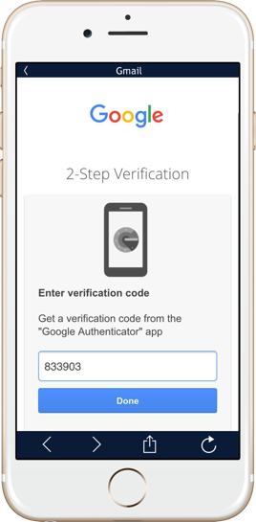
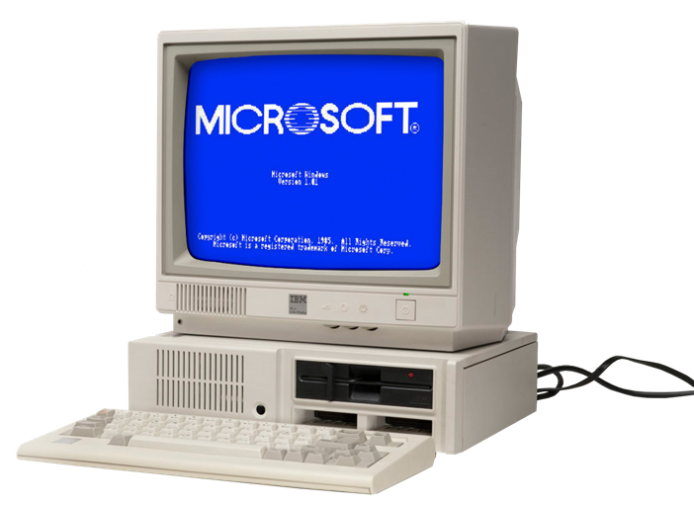




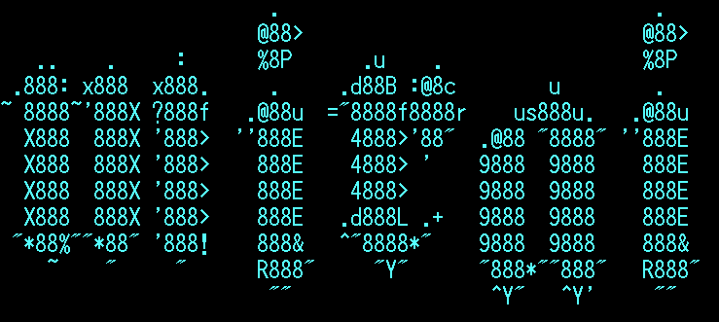


IoT risks: identity
Static credentials
1
MFA
2
Managed identity
3
LDAP
Headless device identity
4
Explosive growth of static credentials
5

Slide 46


Legislation – Identity Requirements
Proposed Federal Law
State Law
California Senate Bill 327
Section 1798.91.05 (b)
The device contains a security feature that requires a user to generate a new means of authentication before access is granted to the device for the first time.
Devices must comply by January 1 2020
Internet of Things (IoT) Cybersecurity Improvement Act of 2019
(2) MATTERS ADDRESSED. – In ensuring efforts are completed under paragraph (1), the Director shall also ensure that such efforts address, at a minimum, the following considerations for covered devices:
Secure Development.
Identity management,
Patching.
Configuration management.
Notes:
Note also pending UK legislation on IoT security

Slide 47
NIST IoT Guidance
NIST Guidance
Considerations for Managing Internet of Things (IoT) Cybersecurity and Privacy Risks
June 2019
(NIST IR 8228)
1 - Protect device security
2 - Protect data security
3 - Protect individuals’ privacy
Notes:
Note also pending UK legislation on IoT security

Slide 48

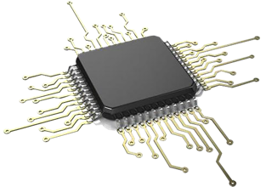
IoT risks: integrity
Firmware
1
Data in transit
2
Data at rest
3

Slide 49















PKI for IoT identity and integrity
Issuance
Provisioning
Operational
TLS encrypted data in transit
Cloud
ERP
Management platform
Offline
root CA
Issuance
CA
EST/REST API
lightweight agent
Device vendor
or supply chain chipset provider
Assembled
product
Gateway
Other
devices
AND/OR
Device integrity
Over the air
firmware
updates
Renewal
Revocation
On-premise
CA
TPM
integration
Multi-phased
secure boot
Data at rest encryption
Embedded firewall

Slide 50









PKI is the best choice for interoperability

Slide 51

Recall what I told you earlier about PKI…
PKI is the best technical solution for identity
Proven | Versatile | Reliable | Secure | Ubiquitous | Widely understood
Purpose-built PKI addresses these concerns
Usable | Agile | Economical | Scalable

Slide 52
Let a security partner help you
Reduce risk of outage or breach
Speed time to delivery
Keep security standards high
Future-proof your cryptography
Maintain interoperability
Free your valuable technical resources for other projects
Save money

Slide 53


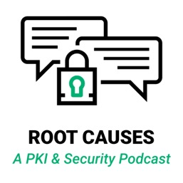







If you liked this talk…

Slide 54

Lindsay Kent
VP of Products
20-year veteran of PKI industry
Research & Development since 2003
Mobile Authentication
patent holder
Leader of Product Team
Continually in contact with customers, partners,
and analysts about PKI Security needs

Slide 55
The Sectigo Product Roadmap

Slide 56
Single platform to serve all varieties of use cases
100% automated
VPN
Breaks out to these components
SSH
DevOps
Public CA
Private CA
Networking
Gear
Public &
Private Web
Server
Certificate Manager
Identity Assurance
Issuance
Mobile
Devices
Email Digital
Signature &
Encryption
Vault
Revocation
Reporting
Windows
Hello for
business
Renewals
Code
Signing
Digital
Sign Forms
loT
Cloud
Access
Certificate provisioning via Industry Standard Protocols

Slide 57

Augment the Microsoft CA
Current State
MSCA provides automation for Windows applications
No automation for non-Windows applications
Sectigo Adds
Continuous discovery of certificates issued by MSCA
Reporting and compliance
Automation of non-windows applications
Option to replace MSCA
cloud
Enterprise
Private CA
Public CA
Microsoft
CA
Applications on Windows Operating System
automated
Certificate
Manager
Optional, Automated, to replace MSCA
manual
non-Windows Apps
Mobile, IoT, Webserver, DevOps, SSH
Automated with industry standards

Slide 58
DevOps
Integrations with popular DevOps tools Docker, Kubernetes, Hashicorp, Ansible, Chef, Puppet, etc.
Monitor local issuance, to check compliance & report on status
Intercept to provide certificates for higher assurance or SSL
DevSecOps team enforces compliance without impacting operations
PKI experience NOT required
Provide for Code Signing of containers
Offline root for Hashicorp vault
Container 1
Container 2
App1
App2
Cert
Authenticate & encrypt communications
Cert
Linux
Linux
Orchestration Tool
Intercept
Sectigo Certificate Management
Monitor
Orchestration Tool CA

Slide 59
Automated SSL Renewal
cloud
Enterprise
Automated renewal of SSL certificates
Standards based, no vendor lock in
Web Admin password not stored in the Certificate Manager agent
Provides certificate management, reporting of all certificates
Saves an hour/cert of Web Admin time
Eliminates chance of error
Fast renewals, key rotation
Private CA
Public CA
Certificate Manager
Web Server, Load Balancer
RFC8555 protocol (ACME)

Slide 60
SSH Key Management
SSH public keys never expire, build up over the years
Discovery of public keys
Delete unused public key
Automated rotation to certificate-based credentials
Supported by OpenSSH and Tectia SSH client/server
Certificates:
  Bind identity to credential
  Expire
  Can be revoked
  Allow for login policies
Single pane of glass for all employee credentials
SSH Server 1
SSH Server 2
Private CA
Admin1 Public Key
Admin1 Public Key
Admin2 Public Key
Admin2 Public Key
Certificate Management
Discovery of Existing Credentials (PKI public key)
SSH Desktop Client
SSH Desktop Client
Certificate enrollment
Admin1 Private Key
Admin2 Private Key
Admin1 Certificate
Admin1 Private Key

Slide 61
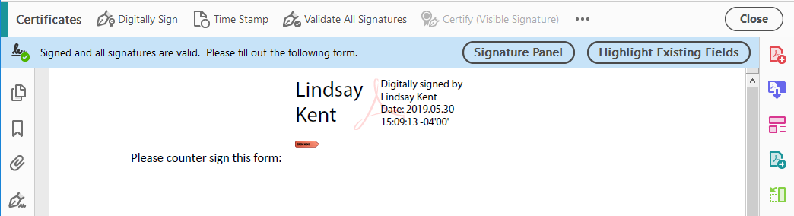
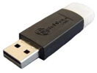
Digital Signature
Digitally sign PDF and Office documents
Legally binding in Europe future
Trusted by Adobe and Microsoft applications world-wide
Credential delivered on USB
Credential delivered on HSM future
Click on signature
to learn more
about author
Option to countersign
contract by click

Slide 62
Customer Premise CA
Customer Premise
For when going over the internet for certs is not desired
Optional EST client provided
Optionally subordinate to a Root hosted by Sectigo
Optional Cloud
Sectigo Root
Customer Premise Private CA
IoT Device
EST
EST
Optional
HSM or TPM

Slide 63
Encrypted and Signed email
Sign eMail that is trusted by all eMail apps world-wide.
  Detects alteration
  Authenticate the sender
Encrypt eMail in mail server & in transit
Sync the same identity in all user mail applications & directory
  Outlook mobile/inTune in Sept
Option to encrypt/sign at gateway
Capability to provision to mobile devices with or without an MDM
  eMail
  Web Authentication
  Replace WiFi password
cloud
Enterprise
Private CA
Public CA
Directory
ID
Windows Outlook
Certificate Manager
ID
ID
Tablet
Mail App
Mail Server
Secure
eMail
Gateway
ID
ID
Key Vault
ID
Mobile
Mail App
ID
External
Recipient
“We deployed the Secure SSL Email Certificate for our end users 4 months ago and was faced with the difficulty of the deployment. Although we created a step by step guide for end users to download and install their own certificate, lot of support requests were received to accomplish the setup. Is there a possibility to switch to Zero Touch in order to facilitate the Certificates management and installation processes.”
ID

Slide 64
















Trusted By Leading Brands Globally

